Slide 1
Office 365 development

Slide 2
Advanced Windows 10 development with the Microsoft Graph API
</>

Slide 3
Agenda
Introduction to Universal Windows Platform
Integrating Office 365

Slide 4
Developer vision
USERS
DATA
HTML

Slide 5
Universal Windows Platform

Slide 6
A bigger opportunity with one Windows…
Universal Windows Platform
Xbox 360
Xbox One
Unified core
Unified app platform
One Store
Converged
OS kernel
Windows 8
Windows 8.1
Converged
app model
Windows Phone 8.1
Windows Phone 8
Easy for users to get and stay current
Windows Phone 7.5
Windows on devices
Notes:
Platform convergence has been a journey which ends today with Windows 10
We started by using the same Internet Explorer code + engine on Windows Phone 7.5 and Xbox 360; and we started implementing the Microsoft modern design language.
With the release of Windows 8, we converged the Windows kernel (which aligns, among other things, the HAL and driver models). Windows Phone 8 took advantage of new lighter-weight kernel to enable multiple CPUs and other improvements, and the Xbox One was built on top of Windows 8. Xbox also introduced xJS, Xbox’s version of WinJS so developers could write apps in HTML/WinJS the same framework as available on Windows 8.
With the release of Windows Phone 8.1 the runtimes from Windows 8.1 and phone came together as well – continuing up the Windows stack and building upon the kernel convergence that happened in 8.0 – aligning the app models and API set, bringing 90%+ API convergence and unification/convergence of things like Windows Notification Services, back-stack behavior, sharing contracts, live tiles, etc.
With Windows 10, we bring complete the unification of Windows families, and now provide a Windows core that can be used on embedded and IoT devices.
Background data:
9/15/11 Windows Phone 7.5
10/26/12 Windows 8
10/29/12 Windows Phone 8
10/18/13 Windows 8.1
11/22/13 Xbox One
4/8/14 Windows 8.1 Update
3/26/14 Windows Phone 8.1

Slide 7
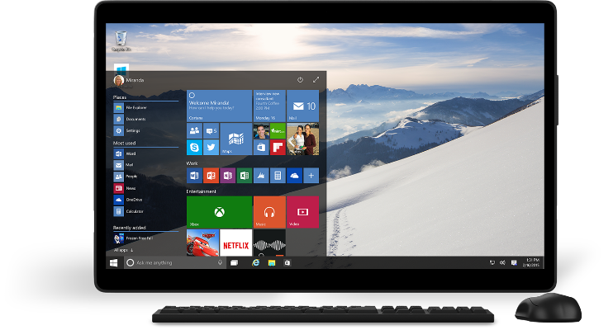
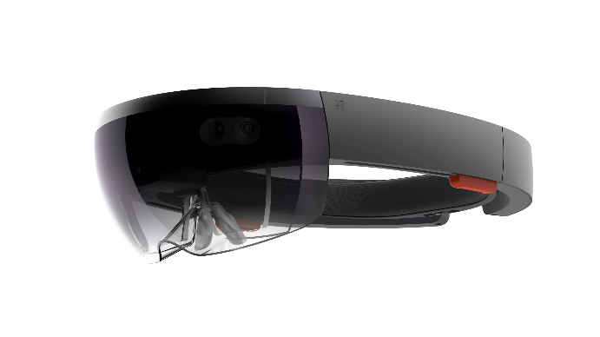
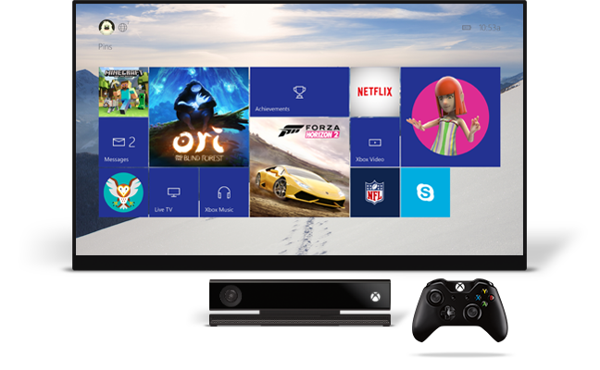
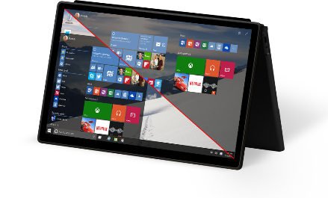
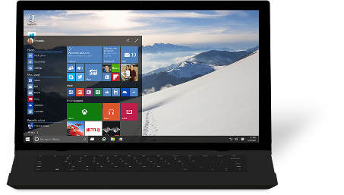
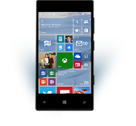
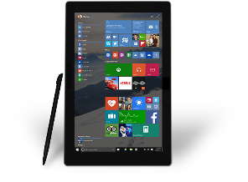
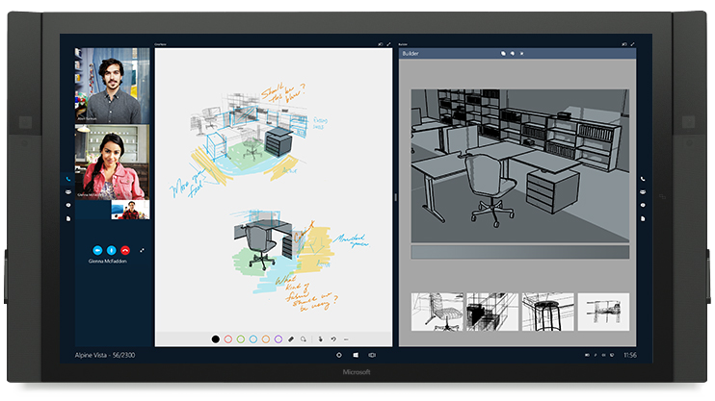
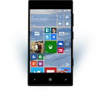










…and one app platform
Universal Windows Platform
Universal Windows platform
PC
Holographic
Mobile
Console
Devices +IoT
Surface Hub
Adaptive user interface
Full support for existing code
Natural user inputs
One store + one dev center
SDK + services
Notes:
To bring the family together, Windows 10 is built upon a unified core (the Windows core) and a unified app platform (Universal Windows platform), meaning that all of our device families run Windows at their core. This provides the consistency that users need and the tailored experiences desire.
Gone are the days of Microsoft maintaining a number of code-bases that works to build bridges across silos; Windows has evolved to do that itself. And gone are the days of ISVs doing this as well – targeting Windows provides a single roadmap to the billion+ Windows screens.
Enabling this consistent, yet tailored, Windows experience are a number of services:
Adaptive UX: User interface design that adapts and reacts to the device family it’s running on
Natural user inputs: Speech, natural ink, gesture and facial recognition
Cloud-based intelligent services: Cortana AI, personal hubs, OneDrive, Office 365, Windows notification services, credential locker
Windows Store: Universally available apps and games, digital media
For the app builder, this also means that you can build one Windows solution that runs across all of the Windows device families, and use these Windows services to tailor your experience at runtime.

Slide 8
Tuned to each form factor
Universal Windows Platform
Windows for PCs
Familiar desktop shell
Broad hardware ecosystem
Windows desktop application compatibility
Windows for phones
Familiar mobile shell
Rich telephony
Windows Phone app compatibility
Windows on Xbox
10’ shell experience
Shared gaming experiences
Game and app compatibility
Windows for…
Form factor-appropriate shell experience
Device-specific scenario support
One core OS
Base OS
App and device platform
Runtimes and frameworks

Slide 9
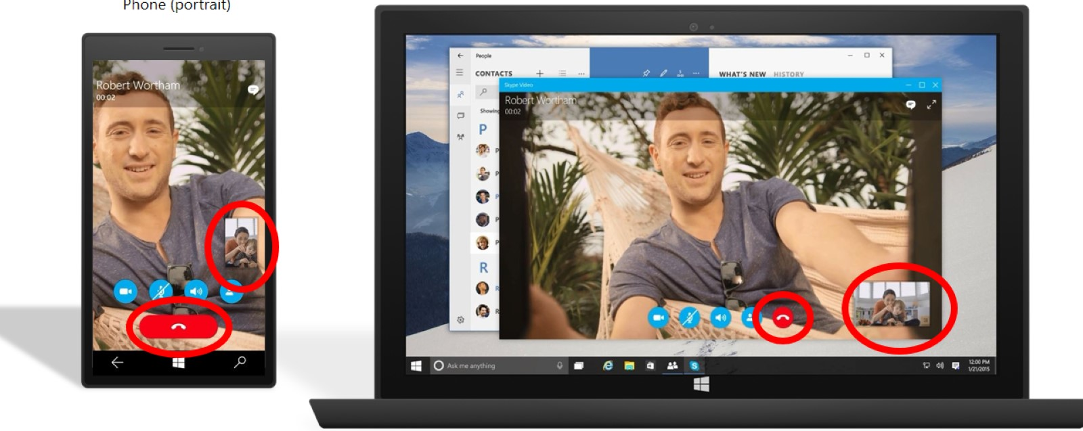
Adaptive UX Same code, same controls, optimized layout
Universal Windows Platform
Tablet (landscape)/desktop
Phone (portrait)

Slide 10
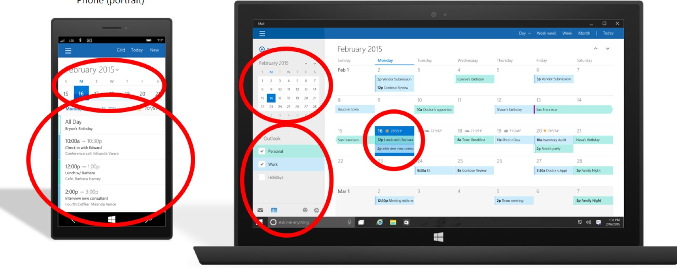
Tailored experiences Based on a set of adaptive control and enable an experience tailored to the device
Universal Windows Platform
Tablet (landscape)/desktop
Phone (portrait)

Slide 11
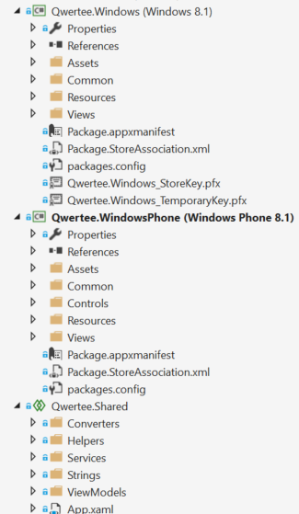
Universal Windows 8.1 apps
Universal Windows Platform
#if WINDOWS_APP
ResourceLoader loader = new ResourceLoader();
string about = loader.GetString("SettingsLabel/Text");
string privacy = loader.GetString("PrivacySettings/Text");
string options = loader.GetString("Settings/Text");
ISettingsService settings = container.RegisterSettingsService();
settings.RegisterFlyoutCommand<AboutViewModel>(about);
settings.RegisterFlyoutCommand<PrivacyPolicyViewModel>(privacy);
settings.RegisterFlyoutCommand<SettingsViewModel>(options);
#endif

Slide 12
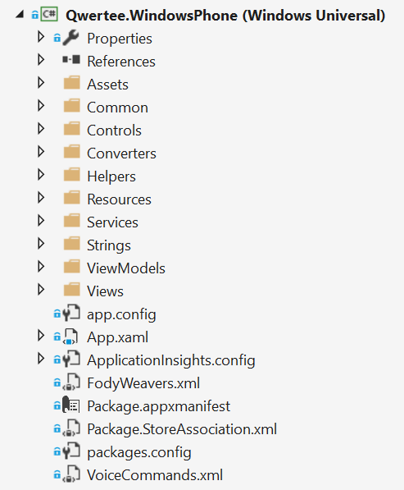
One binary for every device
Universal Windows Platform
No more shared project and specific platforms project
No more conditional code
Only one store
The Universal Windows Platform is available on every Windows 10 device

Slide 13
Universal Windows Platform
Universal Windows Platform
It’s a collection of contracts and extensions
When you create an app you target a version of the UWP, not of the operating system
<Dependencies>
<TargetDeviceFamily Name="Windows.Universal" MinVersion="10.0.10069.0" MaxVersionTested="10.0.10166.0" />
</Dependencies>

Slide 14
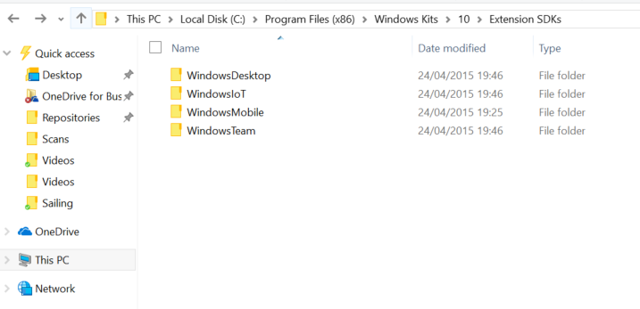
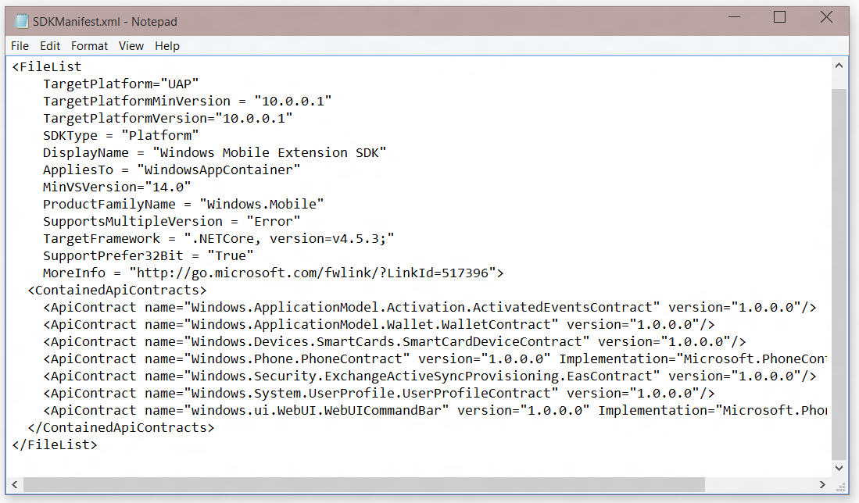
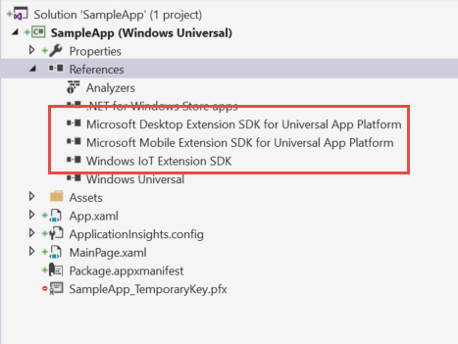
Platform extensions
Universal Windows Platform
SDKs to add specific platform APIs on top of the Universal Windows Platform

Slide 15
Demo: Universal App template
Notes:
Download the following manifest and run to show the sandbox for the new Word APIs: http://1drv.ms/1OiykkN

Slide 16
Integrating Office 365

Slide 17
Add Office 365 to Universal App
Integrating Office 365
Create Azure Active Directory application
Register application in Azure AD and set the appropriate Office 365 permissions
Add ADAL and JSON Nuget Packages
Import necessary assemblies
Create a data source
XAML makes heavy use of data binding, embrace that paradigm
Stateful client
Initiate login/consent and store Discovery Context
Office 365

Slide 18
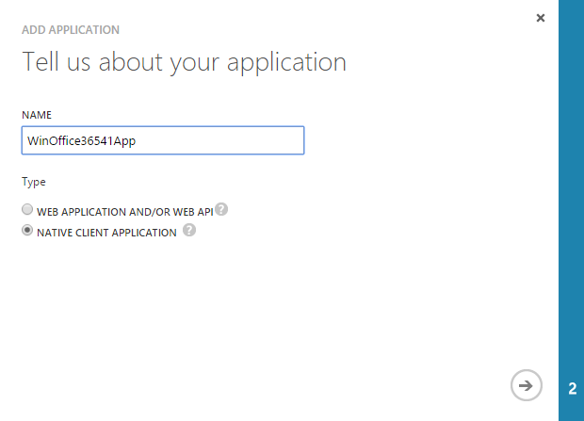
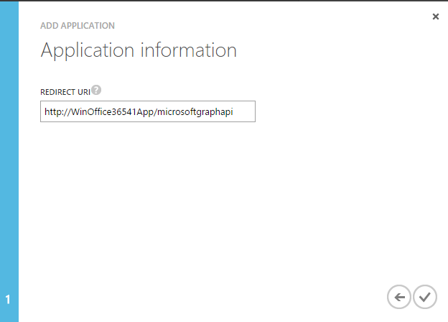
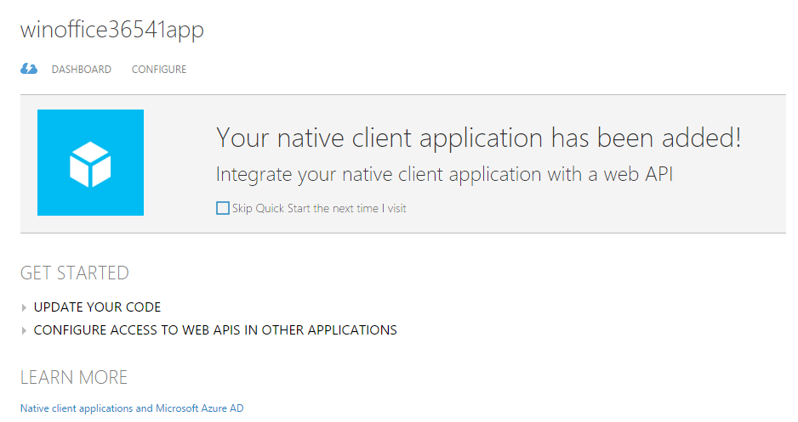
Registering AAD Application
Integrating Office 365
1
Name app
2
Set Redirect URI
3
Finished

Slide 19
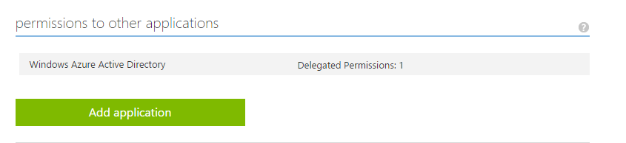
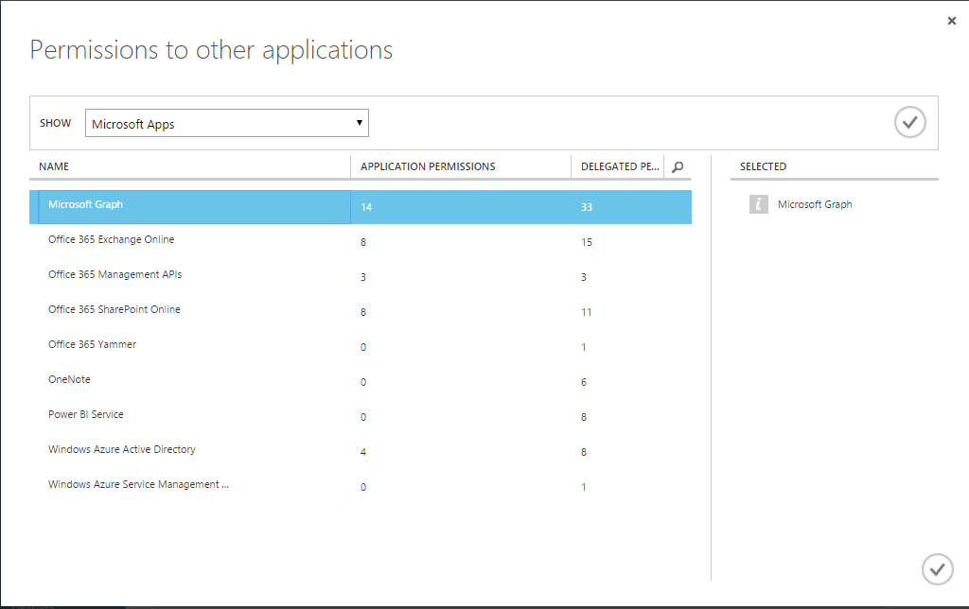
Configure Permissions for AAD Application
Integrating Office 365
1
Add O365 applications to AAD app
2
Select applications

Slide 20
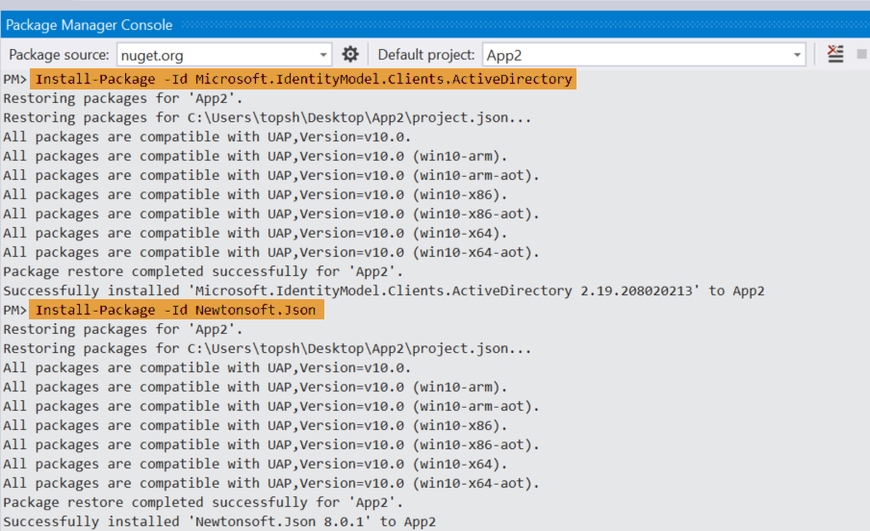
Add Assemblies
Integrating Office 365
Install NuGet Packages for ADAL and JSON

Slide 21
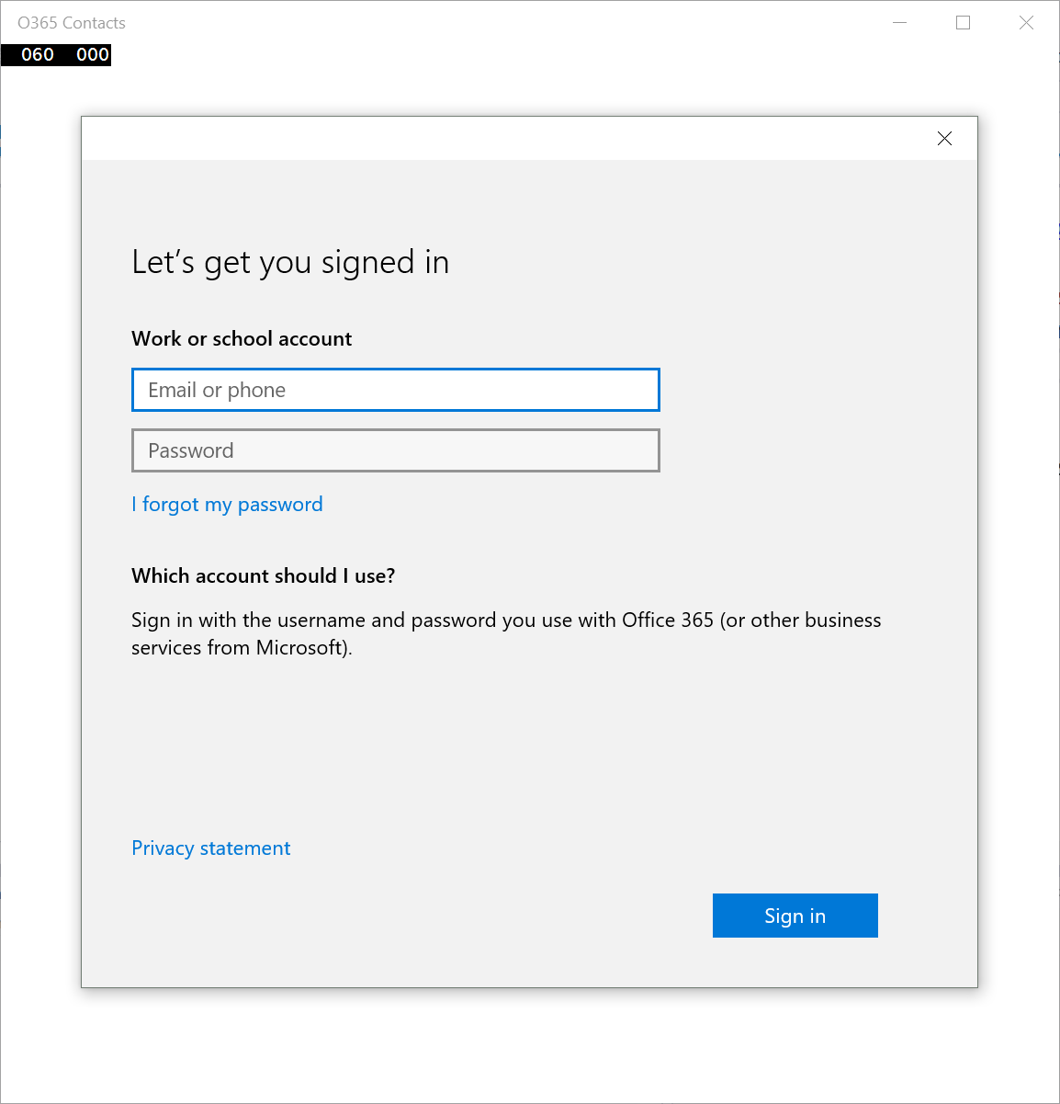
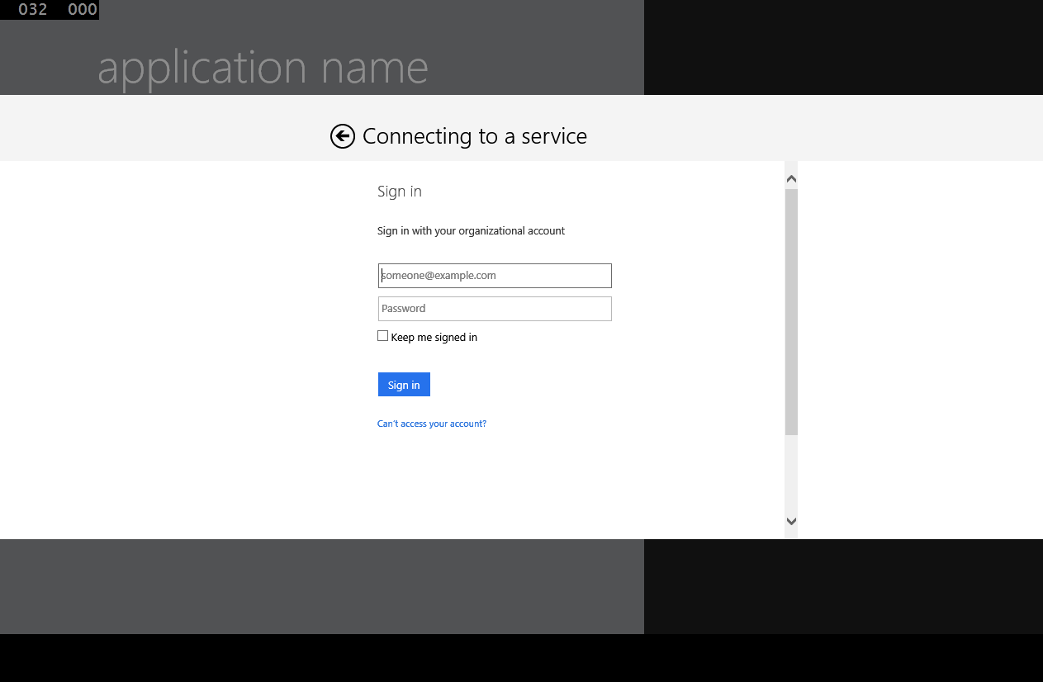
OAuth implementation
Integrating Office 365
Use Web Account Manager when…
In most scenarios as this is the default for connected service wizard
Your app targets Windows 10 and/or multiple logins (see example)
Use Web Authentication Broker when…
Your app uses AAD and ADFS only
Your app targets Win7 and/or iOS/Android (via Xamarin)
You need to target authentication flows not supported by WAM

Slide 22
Authentication compared
Integrating Office 365
Web Account Manager
var webTokenRequest = new WebTokenRequest(aadAccountProvider, String.Empty, CLIENT_ID, WebTokenRequestPromptType.ForceAuthentication); webTokenRequest.Properties.Add("authority", AUTHORITY); webTokenRequest.Properties.Add("resource", resourceId);
webTokenRequestResult = await WebAuthenticationCoreManager.RequestTokenAsync(webTokenRequest);
Web Authentication Broker
var authenticationContext = new AuthenticationContext(String.Format(AUTHORITY, TENANT)); var accessToken = (await context.AcquireTokenAsync(resourceId, CLIENT_ID, RETURN_URI)).AccessToken;

Slide 23
Office 365 Direct Service Endpoint Communication
Integrating Office 365
Direct endpoint “Client” objects for each service
ExchangeClient
SharePointClient
Constructor takes a “token getter” function
DiscoveryContext wraps an AuthenticationContext
AuthenticationContext has methods for getting tokens

Slide 24
Direct endpoint “Client” object constructor example
Integrating Office 365
return new ExchangeClient(ExchangeServiceEndpointUri, async () =>
{
return (await _discoveryContext.AuthenticationContext
.AcquireTokenSilentAsync(
ExchangeServiceResourceId,
_discoveryContext.AppIdentity.ClientId,
new ActiveDirectory.UserIdentifier(
dcr.UserId,
UserIdentifierType.UniqueId)
)
).AccessToken;
});

Slide 25
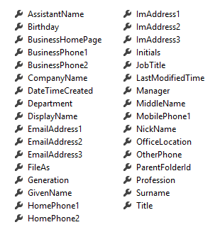
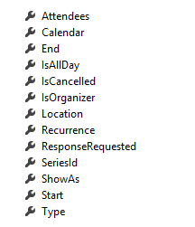
Direct Endpoint Office 365 Service communication
Integrating Office 365
Client Object exposes properties
Most are IEnumerable<T> collections
Designed much like Entity Framework
Client == DataContext
IEnumerable<T> entities
Includes common CRUD operations
Contact
Event

Slide 26
Office 365 Microsoft Graph API Communication
Integrating Office 365
HTTP “Client” objects access all Office 365 services
var accessToken = await GetGraphAccessTokenAsync();
using (HttpClient client = new HttpClient())
{
var accept = "application/json";
client.DefaultRequestHeaders.Add("Accept", accept);
client.DefaultRequestHeaders.Authorization = new AuthenticationHeaderValue("Bearer", accessToken);
using (var response = await client.GetAsync(url))
{
if (response.IsSuccessStatusCode)
return await response.Content.ReadAsStringAsync();
return null;
}
}
Token acquired via ADAL
_authenticationContext = new AuthenticationContext(authority);
_authenticationContext.UseCorporateNetwork = true;
var token = await GetTokenHelperAsync(_authenticationContext, ResourceUrl);

Slide 27
Microsoft Graph API “Client” object constructor example
Integrating Office 365
private static async Task<string> GetTokenHelperAsync(AuthenticationContext context, string resourceId)
{
string accessToken = null;
AuthenticationResult result = null;
result = await context.AcquireTokenAsync(resourceId, ClientID, redirectUri);
if (result.Status == AuthenticationStatus.Success)
{
accessToken = result.AccessToken;
_settings.Values["LoggedInUser"] = result.UserInfo.GivenName;
_settings.Values["LoggedInUserEmail"] = result.UserInfo.DisplayableId;
_settings.Values["TenantId"] = result.TenantId;
_settings.Values["LastAuthority"] = context.Authority;
AccessToken = accessToken;
return accessToken;
}
else {
return null;
}
}

Slide 28
Microsoft Graph API Office 365 Service communication
Integrating Office 365
JSON payloads return information
internal async Task<List<EventViewModel>> GetCalendarEvents()
{
var eventsResults = new List<EventViewModel>();
try
{
var restURL = string.Format("{0}/me/calendar/events?$top=10&$filter=End/DateTime ge '{1}'",
AuthenticationHelper.ResourceBetaUrl, DateTime.Now.ToString("yyyy/MM/dd HH:mm"));
string responseString = await AuthenticationHelper.GetJsonAsync(restURL);
if (responseString != null)
{
var jsonresult = JObject.Parse(responseString);
foreach (var item in jsonresult["value"])
{
EventViewModel calendarEventModel = new EventViewModel();
calendarEventModel.Subject = !string.IsNullOrEmpty(item["subject"].ToString()) ? item["subject"].ToString() : string.Empty;
calendarEventModel.UpdateDisplayString();
eventsResults.Add(calendarEventModel);
}
}
}
catch (Exception el)
{
el.ToString();
}
return eventsResults.OrderBy(e => e.Start).ToList();
}

Slide 29
Demo: Office 365 UWP App
Notes:
Download the following manifest and run to show the sandbox for the new Word APIs: http://1drv.ms/1OiykkN

Slide 30
Summary
Universal Windows Platform
Integrating Office 365

Slide 31
Further reading…
Getting Started with Office Add-ins
Office Add-in Code Samples
Office Add-in Training videos & hands on labs
Office Add-in Snack videos
Office Add-in documentation

Slide 32
Developer Program launch
1 YEAR FREE
E-mail newsletters
Free Developer subscription
Free training
Free tools
Webinars
http://dev.office.com/devprogram

Slide 33


Engage
Office 365 Network
https://www.yammer.com/itpronetwork
Twitter
S
S
t
t
a
a
r
r
t
t
@OfficeDev
Stack overflow
[Microsoft-office]
Channel 9 Dev Show
http://aka.ms/O365DevShow
Podcasts http://dev.office.com/podcasts
Snack Demos
http://aka.ms/o365DevSnackDemos
UserVoice
http://officespdev.uservoice.com/

Slide 34
Thank you

